Slide 1

Company X

Slide 2
Purpose
Upgrade Network Infrastructure
Enhance End User and System Security

Slide 3

Company Overview
Company x was founded in 1895
Hosted 4 PGA Major Championships and a Ryder Cup
Today Company x has 10 18-hole Golf Courses, 4 Hotels, and a Spa.
Preparing to Host US Open in 2024

Slide 4
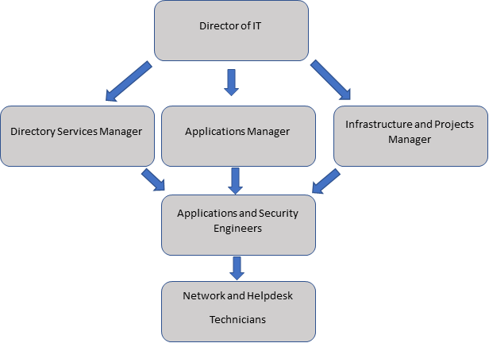
IT Governance Structure
Company X does not currently implement a strict IT Governance Structure
The following entities determine if Company X’s information technology is being used efficiently and effectively to execute the corporation's operational goals:
Director of IT, oversees the entire IT department
Second layer of structure consists of 3 managers
Directory Services Manager, Applications Manager, and an Infrastructure/Projects Manager
Third tier of structure consists of 3 engineers
2 Applications Engineers and 1 Security Engineer
Last tier of structure consists of 4 technicians
1 Network Technician and 3 Helpdesk Technicians

Slide 5
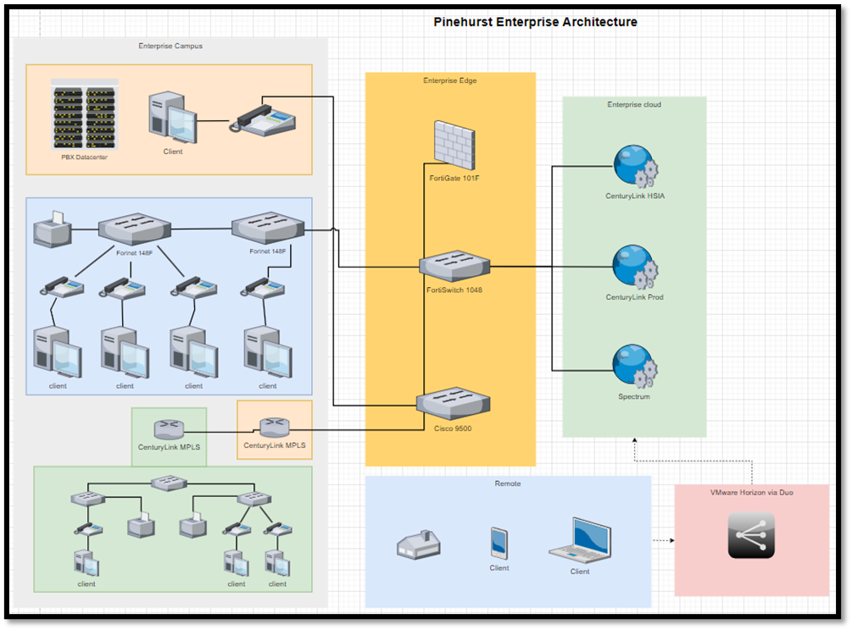
Enterprise Architecture

Slide 6
Project Scope
Goal is to provide an analysis for Company X by assessing how to execute upgrades and improvements to current on-site facility connections to reach maximum connectivity and security goals.
We will address how the company will implement transitioning from a packet forwarding system (MPLS) to a more modern grouping technology (E-LAN).
Focuses:
Systems security, awareness training, muti-factor authentication, mobile device management solutions, and email security.
After analysis we will use findings to conduct a risk assessment, needs assessment, gap analysis, and a SWOT analysis further along the project.
All findings and recommendations for improvements and solutions will be supported with documentation.

Slide 7
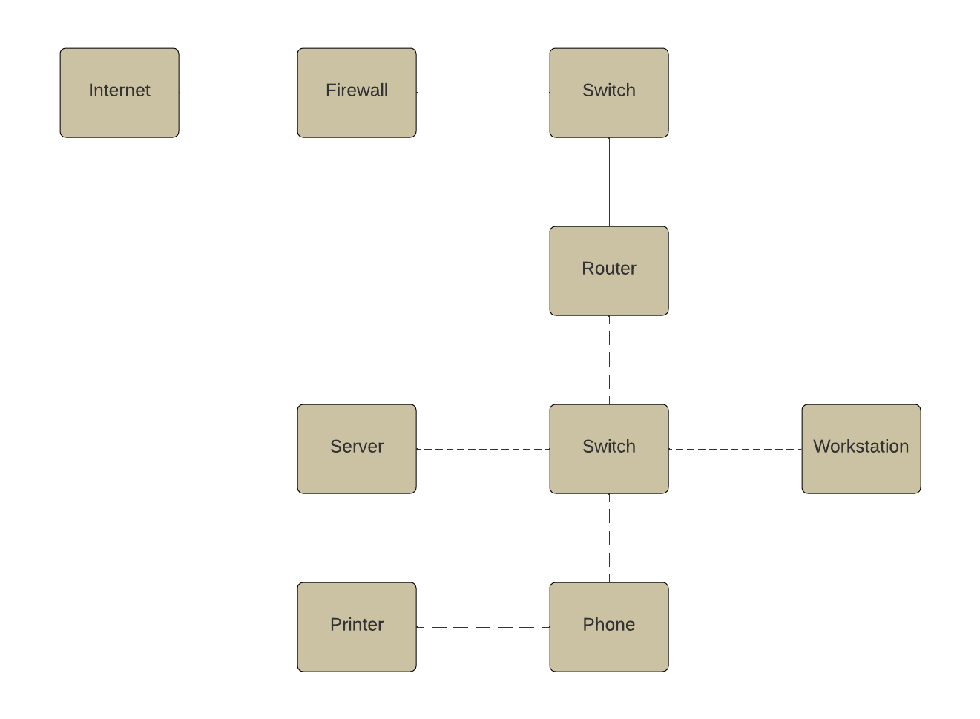
Current Network - Logical

Slide 8
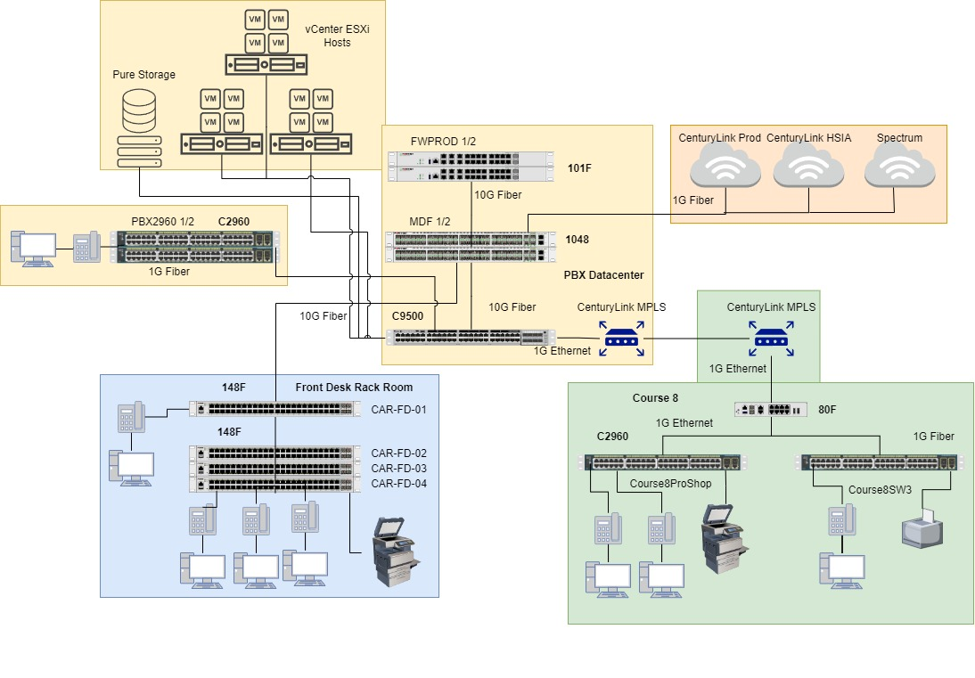
Current Network – Physical

Slide 9
Summary of Findings
Next steps
IT department lacks a formal IT governance structure
Analyze upgrades for Company X’s on-property facility connections, focusing on transitioning from MPLS to E-LAN technology.
RBAC Implementation: Enhance user access control with RBAC.
Internet Entry Firewall: Place a firewall at the internet entry point.
Optimize Routing: Improve traffic routing for efficiency.

Slide 10
Needs Assessment
4 hotels, 5 clubhouses across Company X’s area
Fiber backbone comprised of 10G and 1G fiber
Needs new firewalls to meet network demands
Looking to replace 1G fiber with 10G fiber
Lacking PAM solution
Notes:
Sprawling campus across the Village of Pinehurst, 4 hotels and 5 clubhouses.
Existing fiber backbone, lots of 1G fiber looking to replace with 10G
Need a new firewall to meet the demands of switch management and intrusion detection features
Lacking a privileged access management solution. Currently use spreadsheets

Slide 11
Risk Assessment
Host of the 2024 US Open Golf Championship
Open to financial, reputation, productivity and legal risks
Need to mitigate threats such as:
Firewall: capacity and capability
VisualOne: running on legacy code and single point of failure
Employees: Liability for data exposure and malware
Malware: risk to business operations

Slide 12

GAP ANALYSIS
WHERE COMPANY X RESORT IS AT NOW:
1 Gigabit Connections
Cisco Equipment
Lacks RBAC, NAC, and PAM
Limited KnowBe4 security awareness
WHERE COMAPNY X RESORT NEEDS TO BE:
10 Gigabit Connections
Fortinet Equipment
RBAC, NAC, and PAM
Heightened security awareness via KnowBe4 and Arctic Wolf
HOW TO BRIDGE THE GAP?
Beginning upgrade connections at main site then remote/satellite locations
We recommend transitioning to FortiNAC and FortiPAM
Utilizing more of KnowBe4's educational content rather than focused on phishing
Expand on Arctic Wolf training
Implementing security awareness

Slide 13
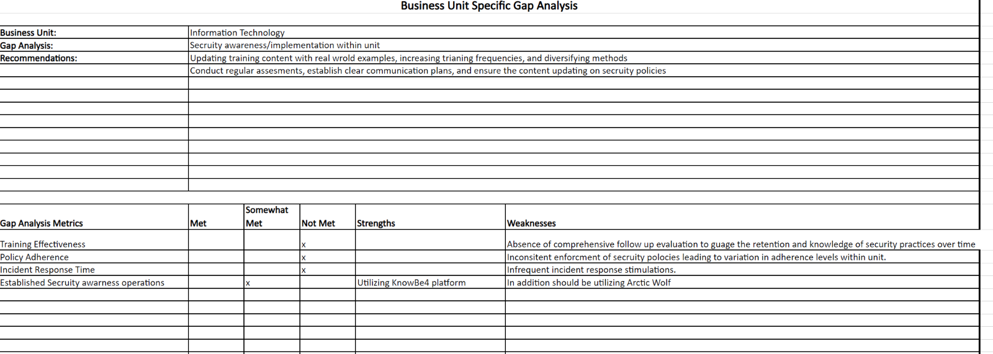
GAP ANALYSIS: SECURITY AWARENESS/IMPLEMENTATIONS

Slide 14
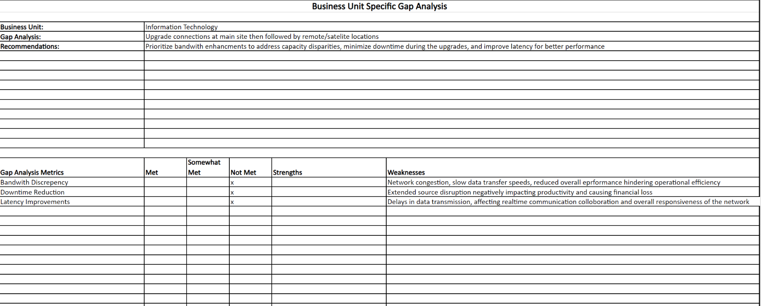
GAP ANALYSIS: UPGRADE CONNECTIONS AT MAIN/REMOTE LOCATIONS

Slide 15
SWOT ANALYSIS
Strengths | Weaknesses
Strong business architecture and competitive advantage Environmental sustainability practices Well-structured framework Large number of amenities/accommodations for customers to guarantee returning guests and ensure profitability Utilization of MFA and RDP | Outdated equipment Limited IT governance Narrow security training Lack of NAC, RBAC, and PAM
Opportunities | Threats
More reliable network connections Heightened security awareness via Arctic Wolf and KnowBe4 Implementation of NAC, RBAC, PAM IT governance expansion Utilization of EDR/MDR/SIEM Upgraded firewalls and switches to facilitate the conversion from MPLS to ELAN | Security breaches: phishing, malware, ransomware, social engineering Unauthorized access to restricted material Data loss Natural Disasters Theft

Slide 16
Migration Plan
Phase I: Upgrade Connections
Phase II: Transition from MPLS to ELAN
Phase III: Cisco to Fortinet Transition
Phase IV: Security Awareness
Initial Phase
Upgrade to 10 Gbit Connections
Phase II
MPLS to ELAN Transition
Phase III
Cisco to Fortinet Transition
Final Phase
Implement Security Awareness & Upgrade Observation
Approx. 2 months
Approx. 3 months
Approx. 3 months
Approx. 2 months

Slide 17
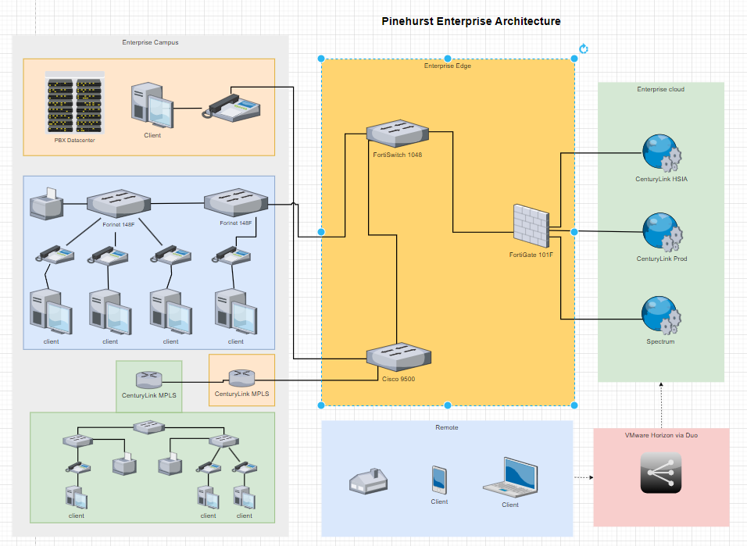
Enterprise Architecture Revised

Slide 18

Physical Network Diagram (Revised)

Slide 19
Detailed Budget

Slide 20
Detailed Budget

